Slide 1
Lightweight LangChain-based PII Detection System

Slide 2

01
Purpose of Lightweight LLM-based PII Detection
02
LangChain + Hugging Face Integration
Presentation Overview
03
Fallback Mechanism: Regex
04
Detection Output Details
05
Batch Analysis & Redaction

Slide 3

Introduction to Lightweight PII Detection
Why Lightweight?
Lightweight LLM-based systems offer fast, efficient PII detection without the resource overhead of massive models.
Focus on Multilinguality
Supporting English, French, and Arabic ensures broader application in diverse environments.
Applications
Ideal for edge deployments, SaaS products, and GDPR-compliant lightweight solutions.

Slide 4

LangChain Integration with HuggingFaceHub
Model Choice
We use bigscience/bloom model via HuggingFaceHub API for lightweight but capable text understanding.
Prompt Templates
Custom prompts designed per language (English, French, Arabic) ensure efficient and accurate PII extraction.
LangChain Usage
LangChain manages prompt generation, model calls, and output parsing seamlessly in a lightweight pipeline.

Slide 5

01
When LLM fails or is uncertain
02
Fallback to Regex-based entity extraction
Fallback Mechanism: Regex Backup
03
Regex covers emails, phones, addresses
04
Ensures no missed critical PII
05
Improves reliability under resource constraints

Slide 6

Detection Output Details
Entity Structure
Each detected entity includes type (name, email, phone), text content, start and end positions, confidence score, and detection method (LLM or Regex).
Confidence Scoring
Confidence scores are provided when available, helping assess output reliability.
Standardized Output
All detections follow a common schema for easy integration into downstream systems.

Slide 7

Redaction Strategies by Entity Type
Custom Redaction Approaches
Different entity types are handled uniquely. For example, emails may be replaced with '[EMAIL]', phones with '[PHONE]', and names with masked versions.
Address and Credit Cards
Addresses are partially masked for city-level granularity; credit cards are fully obfuscated except the last 4 digits.
Flexible Redaction
Strategies can be easily customized based on compliance needs (GDPR, HIPAA, etc.).

Slide 8
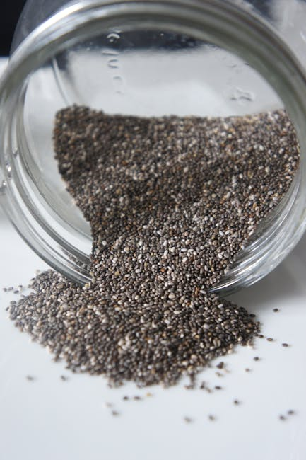
Batch Analysis Capability
Parallel Analysis
The system can process multiple texts in batch mode, leveraging concurrency for faster results.
Efficient Resource Use
Batch processing optimizes model API calls, reducing cost and latency.
Scalable to Large Datasets
Lightweight design enables scaling from a few documents to thousands with minimal resource overhead.

